Slide 1
Research Experience for Undergraduates, FSU 2019
Metal Chalcogenides for Fun and Profit
Susan E. Latturner
Department of Chemistry
Florida State University
Inorganic extended solids
Band structure basics
Metal chalcogenides
Flux growth

Slide 2
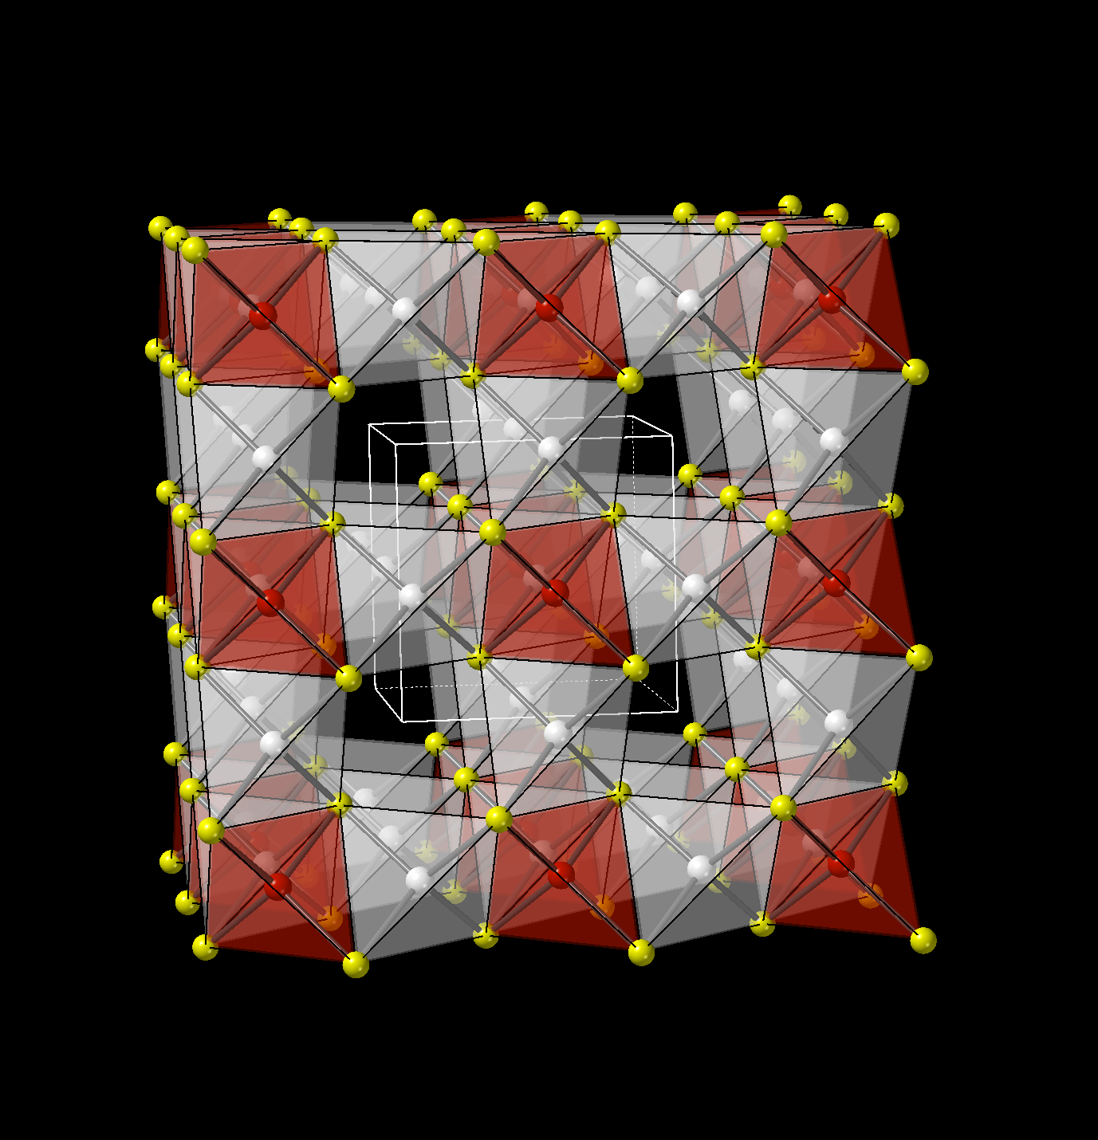
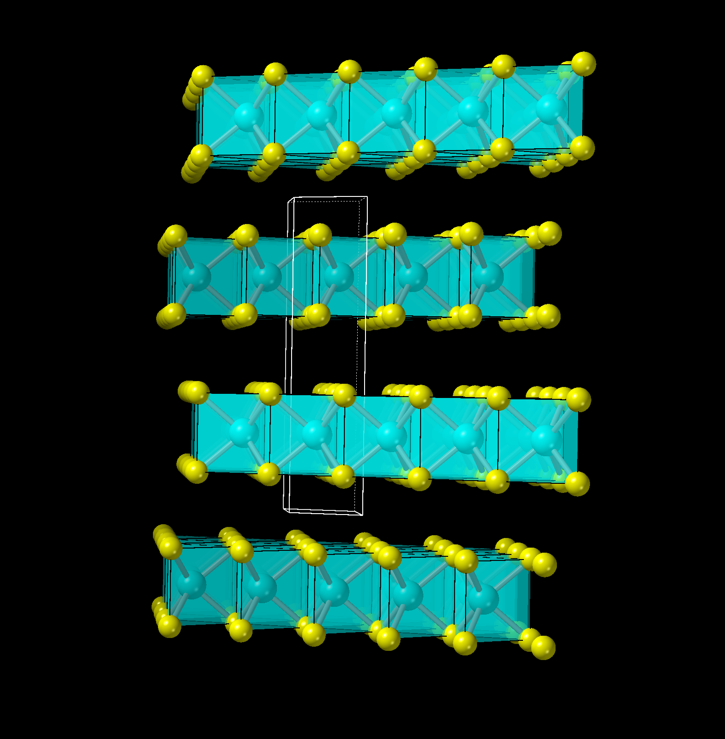
Inorganic Extended Solids: Crystal structure
Organic compounds: focus is on discrete molecular units
Interactions between the molecules not important
Inorganic extended solids: atoms are bonded in infinite 3-D array
Pattern of repeating unit cells pack together to fill space
    Size, symmetry of unit cell and position of atoms in it = crystal structure
Cu₃VSe₄
Cubic
P ͞4 3 m
a = 5.5636(5) Å
MoSe₂
Hexagonal
P 6₃/m m c
a = 3.2880 Å
c =12.9000 Å

Slide 3
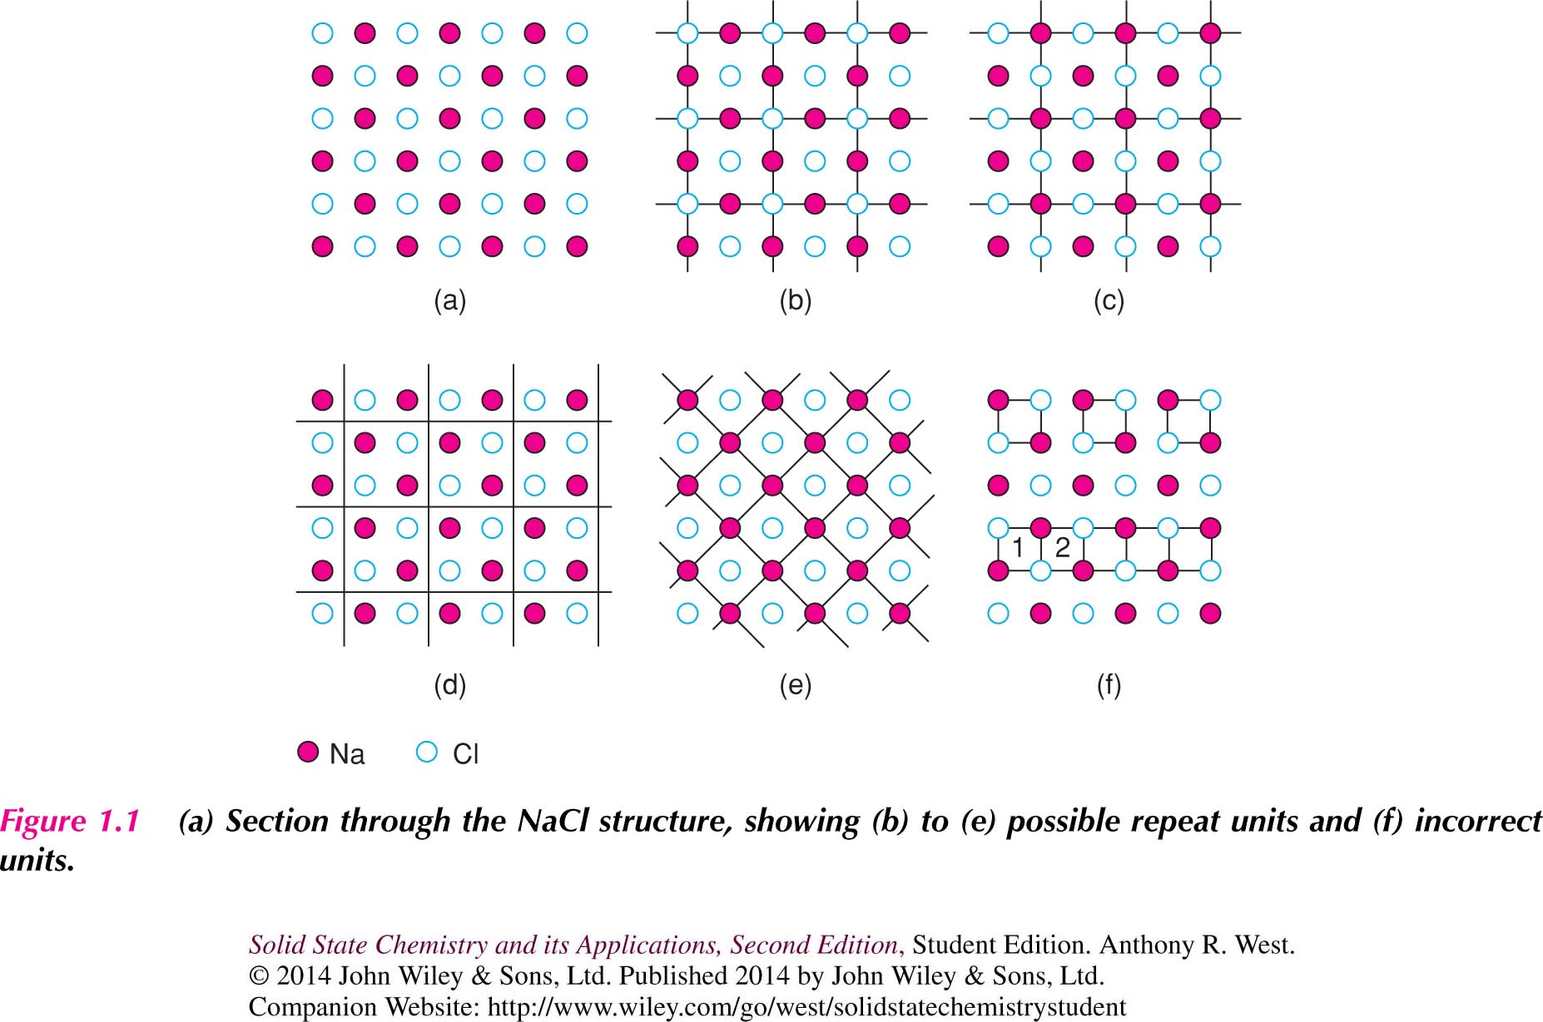
Unit cell

Slide 4
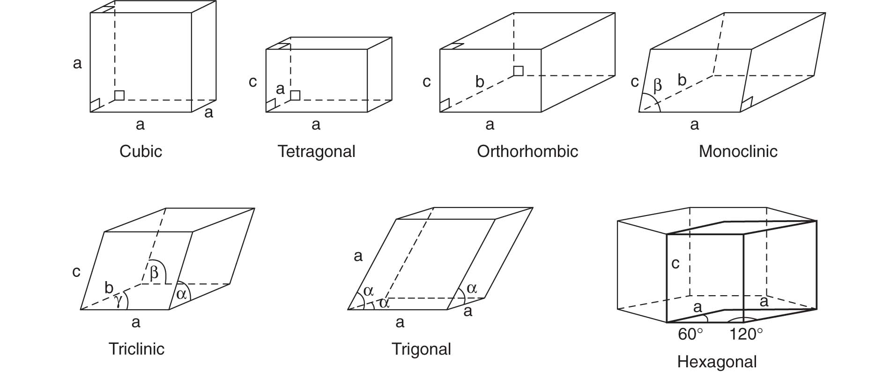
Seven Crystal Systems
Cubic
Tetragonal
Orthorhombic
Hexagonal
Trigonal/Rhombohedral*
Monoclinic
Triclinic

Slide 5
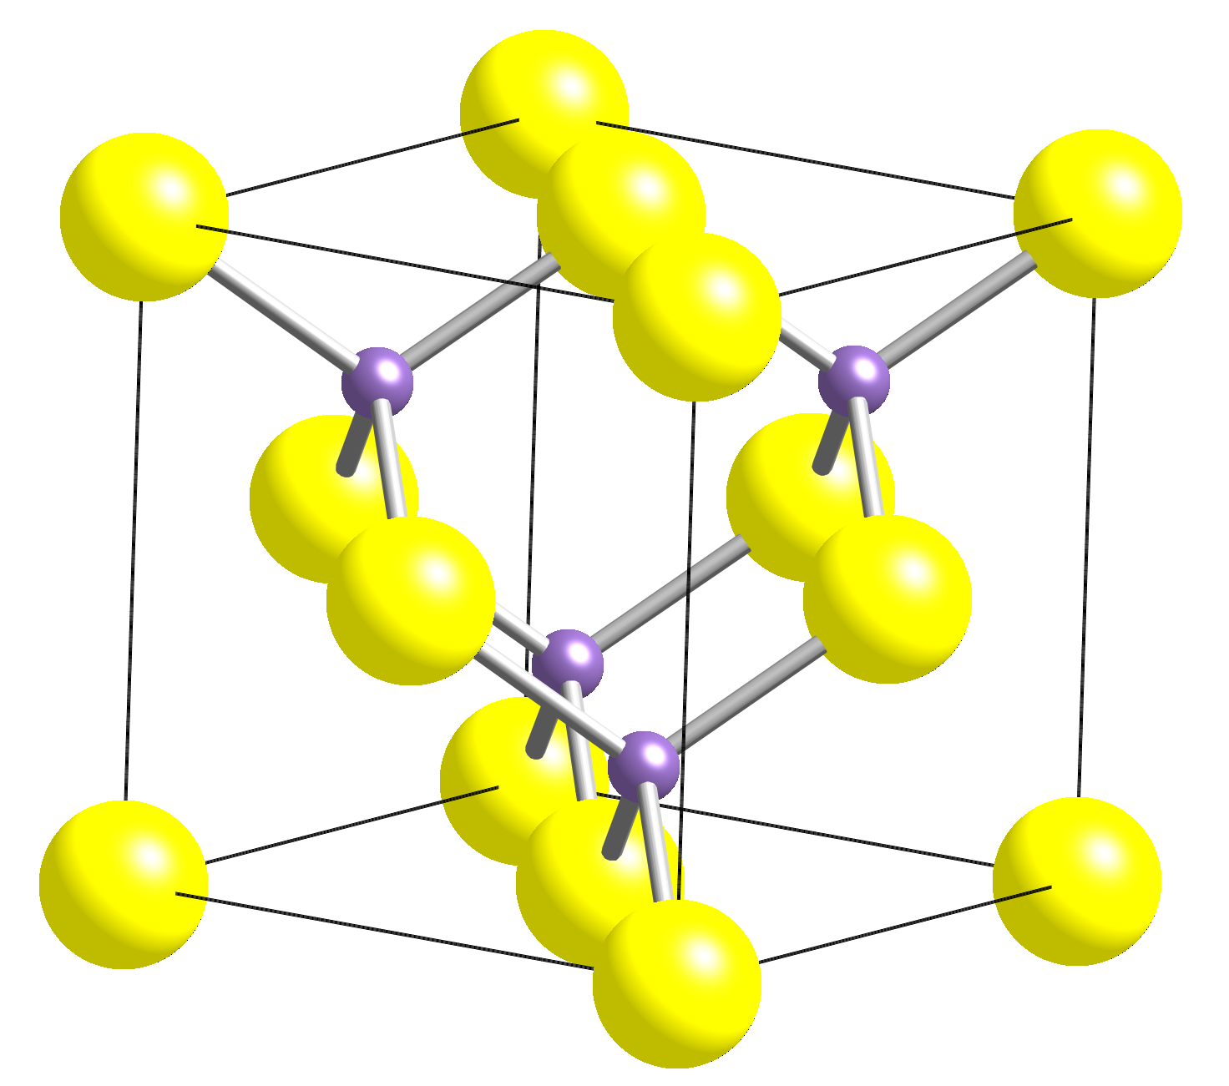
Structures derived from ccp (fcc) layers of anions
ZnS
Zinc blende / Sphalerite
Half of tetrahedral sites filled
cubic, F4-3m
a = 5.406Å

Slide 6
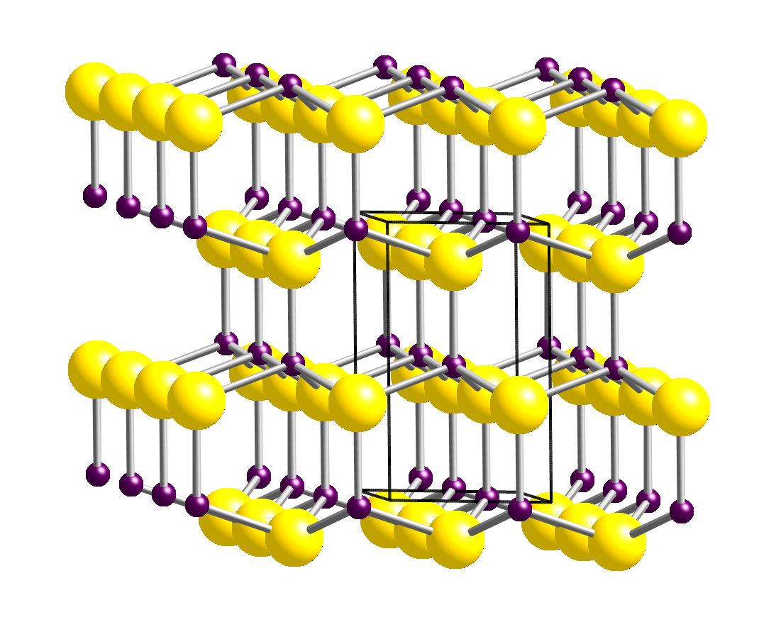
Structures derived from hcp packing of anions
ZnS, Wurtzite
Half of tetrahedral sites filled
hexagonal, P6₃mc
a = 3.811Å, c = 6.234Å
High temperature form

Slide 7
Crystal structure
Zinc Selenide, ZnSe
Space group F4-3m
a = 5.633 Å
CuGaSe₂
Tetragonal
Space group I-42d
a = 5.614 Å
c = 11.022 Å
Take “Zn₂Se₂” and substitute Cu⁺ and Ga³⁺ for Zn²⁺ cations. Cu and Ga siting on the Zn sites is not random; “coloring pattern” lowers symmetry from cubic to tetragonal, doubling one of the axes

Slide 8
Band Structure
For an extended solid the band structure plays the same role that an MO diagram does for a molecule.
Band structure is the link between crystal structure, bonding and properties.
Electronic conductivity
Optical properties, including absorbance
Electronically driven structural distortions
Magnetic Properties of Metals
Catalytic Activity

Slide 9
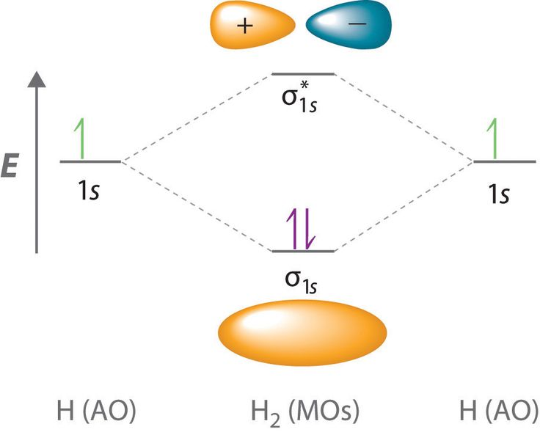
Molecular orbitals vs bands
Positioning and spatial overlap of atomic orbitals in an ordered crystalline material will result in bonding and band formation.
An extended 3-D version of what happens in a molecule
Molecule: atomic orbitals interact to form stabilized bonding molecular orbitals and higher energy antibonding MO’s
Bulk solid: millions of atomic orbitals interact to form “crystal orbitals” that extend through the entire crystal. These crystal orbitals are grouped into bands.

Slide 10
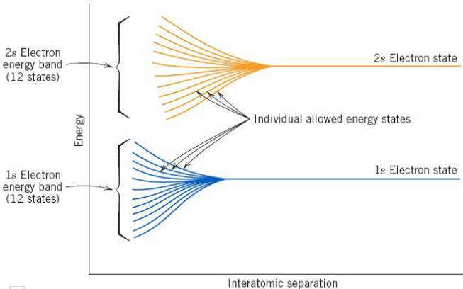
From atom to many atoms
When 12 atoms aggregate, their atomic orbitals interact to form bonding and antibonding states
W.D. Callister, Materials Science and Engineering: An Introduction

Slide 11
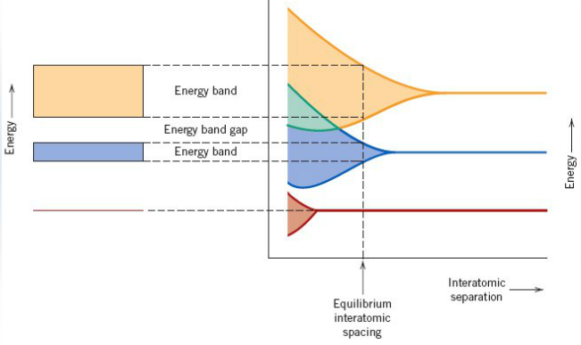
Density of States—bulk material
Bands form as atoms go from well-separated to packed together in a bulk solid at their stable equilibrium positions
Millions of atoms → millions of crystal orbitals or “states” packed into energy bands

Slide 12
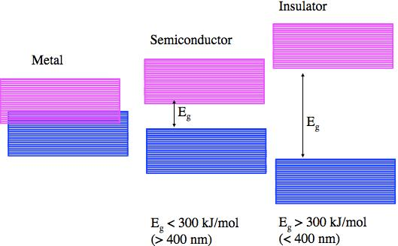
Density of States
Empty states
Filled states
Metals: no bandgap between filled and unfilled states
Semiconductors: bandgap; E_{g} between 0 – 4 eV
Insulators: large bandgap; E_{g} > 4 eV

Slide 13
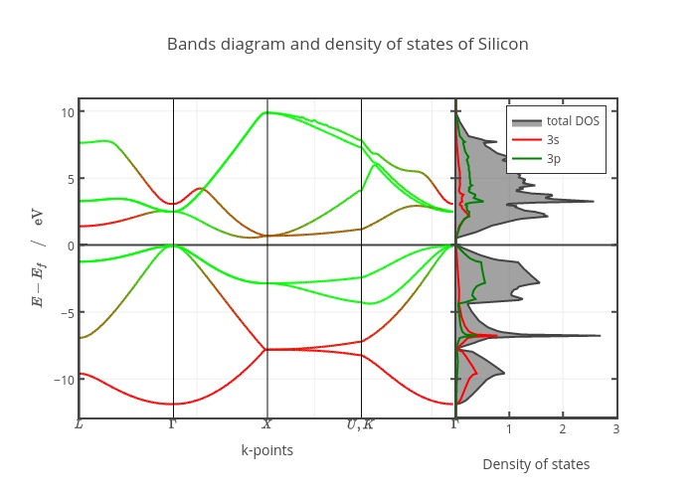
Density of States of Silicon
Empty states (conduction band, CB)
Band gap (E_{g})
Fermi level (E_{F})
Filled states (valence band, VB)

Slide 14
Band gaps of semiconductors
Material | Band gap (eV)
InAs | 0.4
Ge | 0.67
GaSb | 0.7
Si | 1.11
InP | 1.34
GaAs | 1.43
CdSe | 1.74
SnS₂ | 2.2
CdS | 2.42
ZnSe | 2.8
TiO₂ | 3.0
GaN | 3.37
ZnS | 3.6
Diamond | 5.46 - 6.4 eV
(insulator)

Slide 15
Color in Extended Inorganic Solids
Intratomic (Localized) excitations—isolated TM ions in solids
Cr³⁺ Gemstones (i.e. Cr³⁺ in Ruby and Emerald)
Blue and Green Cu²⁺ compounds (i.e. malachite, turquoise)
Blue Co²⁺ compounds (i.e. Al₂CoO₄, azurite)
Charge-transfer excitations (metal-metal, anion-metal)
Fe²⁺ → Fe³⁺ in Prussian Blue
O²⁻ → Cr⁶⁺ in BaCrO₄
Valence to Conduction Band Transitions in Semiconductors
WO₃ (Yellow)
CdS (Yellow) & CdTe (Black)
HgS (Cinnabar - Red)

Slide 16
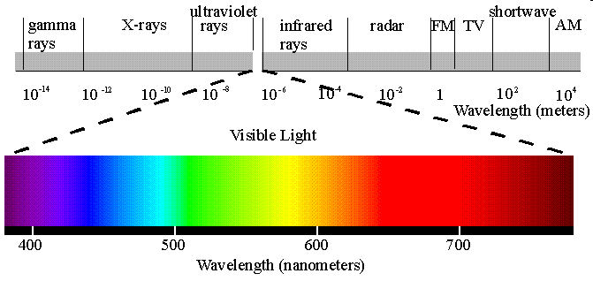
Electromagnetic Radiation and the Visible Spectrum
UV 100-400 nm 12.4 - 3.10 eV High energy
Violet 400-425 nm 3.10 - 2.92 eV
Blue 425-492 nm 2.92 - 2.52 eV
Green 492-575 nm 2.52 - 2.15 eV
Yellow 575-585 nm 2.15 - 2.12 eV
Orange 585-647 nm 2.12 - 1.92 eV
Red 647-700 nm 1.92 - 1.77 eV
Near IR 10,000-700 nm 1.77 - 0.12 eV Low energy

Slide 17
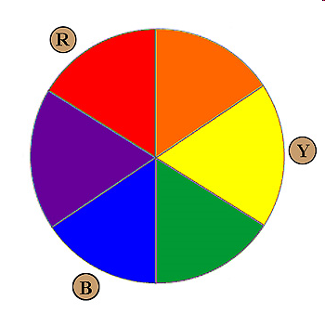
Color of a material = color reflected from it into our eyes
Color reflected = color not absorbed
Emission is a different process (observing energy emitted by a material that is going from excited state to ground state)
If absorbance occurs in one region of the color wheel the material
appears with the opposite (complimentary color). For example:
material absorbs violet light → Color = Yellow
material absorbs red light → Color = Green
material absorbs violet, blue & green → Color = Orange-Red
material absorbs red, orange & yellow → Color = Blue

Slide 18
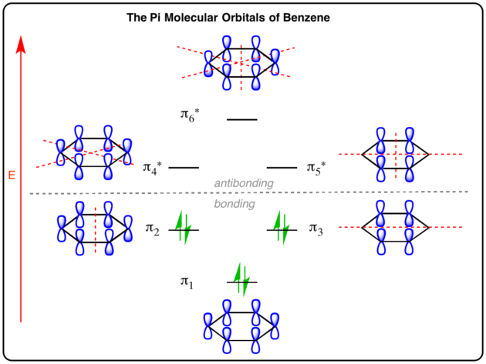
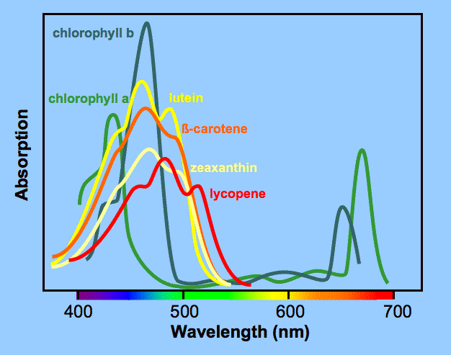
Absorption spectra of molecular species
Discrete energy levels lead to narrow peaks

Slide 19
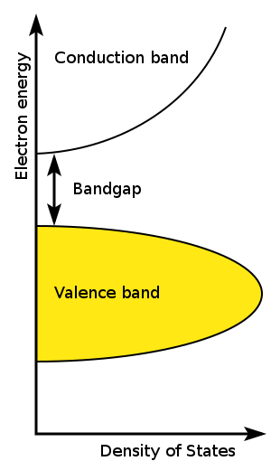
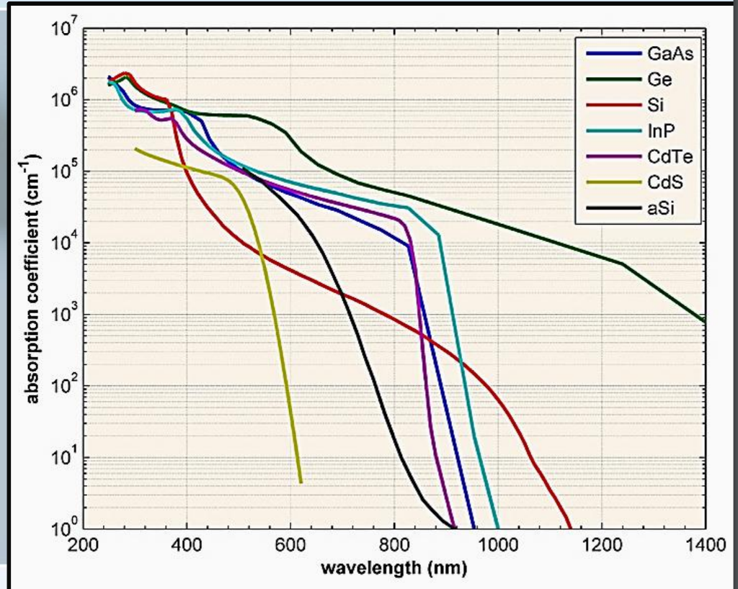
Absorption spectra of crystalline semiconductors
Transition between valence band states and conduction band states leads to broad absorbance
(empty states)
(filled states)

Slide 20
Color of semiconductors
Eg > 3 eV white
Eg < 1.5 eV black
In between: yellow, orange, red
absorbance
300 400 500 600 700
Wavelength (nm)

Slide 21
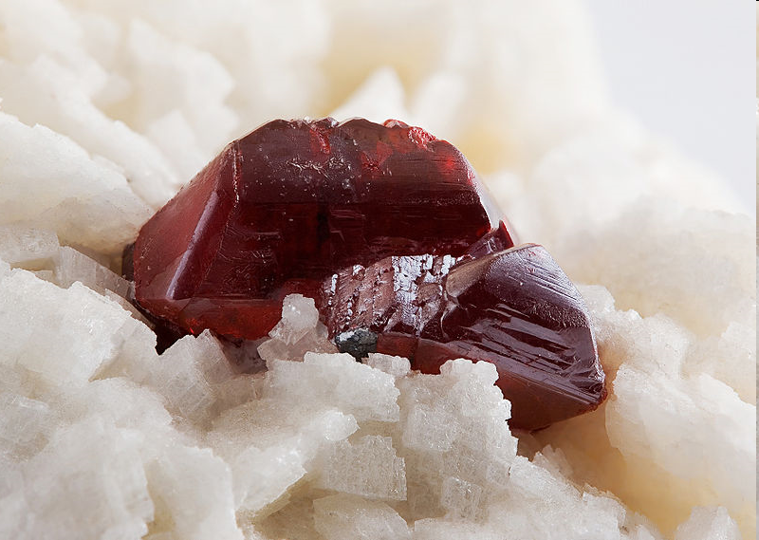
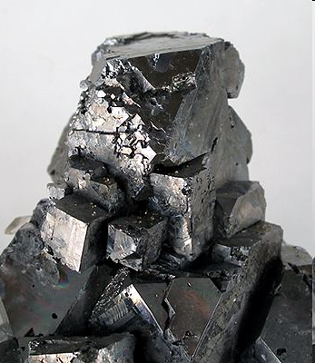


Ancient metal sulfide pigments
PbS, galena
(E_{g} = 0.37 eV)
Eyeliner/kohl
HgS, cinnabar
(E_{g} = 2.0 eV)
Vermilion pigment
Red tattoo ink

Slide 22
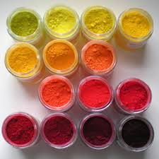
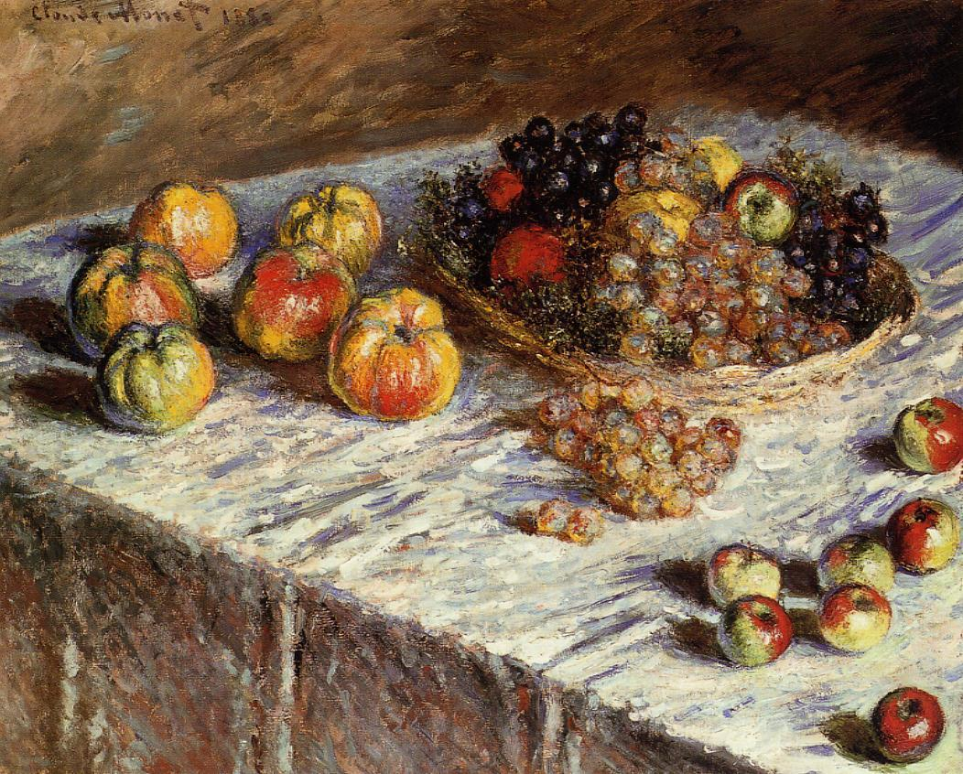
Metal sulfide pigments
Cadmium-based pigments used from Impressionist era to today
Cadmium yellow (CdS)
Cadmium orange (CdS_{1-x}Se_{x})
Cadmium red (CdSe_{1-x}S_{x})

Slide 23
Bandgap Engineering
Control of band gap by substitution of one ion for another
Isovalent substitution (same charge ion)
CdS Eg = 2.42 eV CdSe Eg = 1.74 eV
CdS_{1-x}Se_{x} Eg = 1.74 to 2.42 eV, depending on x
CuGaSe₂ Eg = 1.7 eV CuInSe₂ Eg = 1.0 eV
CuIn_{1-x}Ga_{x}Se₂ Eg = 1.0 to 1.7 eV, depending on x
Aliovalent substitution (substituted ion has different charge)
    Can substitute higher and lower valent cations simultaneously to balance charge, but they may order and change structure.
(ZnSe)₂ → CuGaSe₂

Slide 24
Shifting band energies
(cation states)
CdS E_{g} = 2.42 eV
CdSe E_{g} = 1.74 eV
CdS_{1-x}Se_{x} E_{g} dep on x
(anion states)

Slide 25
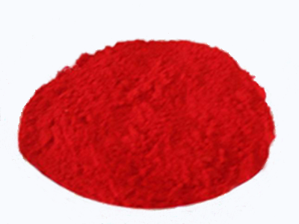
ZnS (Eg = 3.6 eV) ZnSe (Eg = 2.8 eV)
The above items are carefully grown single crystals of ZnS or ZnSe which have been cut into shapes. A lot of solar cell engineering involves growth of large crystals or deposition of single crystalline films.
CdS (Eg = 2.45 eV) CdSe (Eg = 1.74 eV) CdTe (Eg = 1.45 eV)

Slide 26
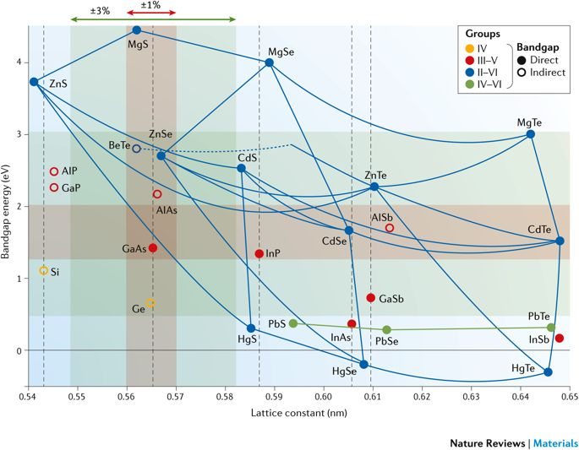
Band gap engineering
Controlled modification of band gap energy by substitution of one element for another in a compound
Vegard’s law—E_{g} should be directly proportional to substitution amount

Slide 27
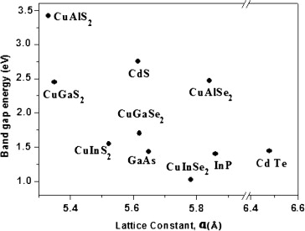
Bandgap Engineering in CIGS
Cu(In/Ga)S₂ and Cu(In/Ga)Se₂

Slide 28
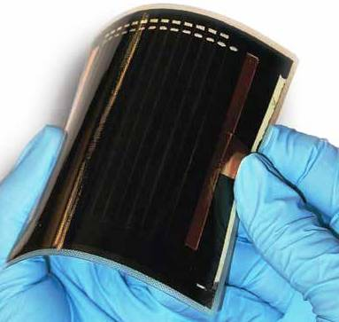
CIGS: Cu(In/Ga)Se₂
Excellent absorber (thin films sufficient to product good photocurrent from sunlight)
Band gap tailorable in the most intense region of sunlight (1 – 1.5 eV)

Slide 29
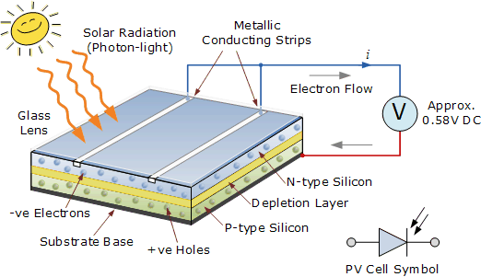
Solar cells
Materials for use in solar cells absorb part of the light emitted by the sun
This causes an e- to go from a low energy orbital/state to a higher energy orbital/state
This excited electron and the hole where it used to be must then separate (go to opposite sides of the device)—this occurs at a junction in the device
Thus the absorbance of light will produce a voltage (due to separated e- and h+): photovoltaic

Slide 30
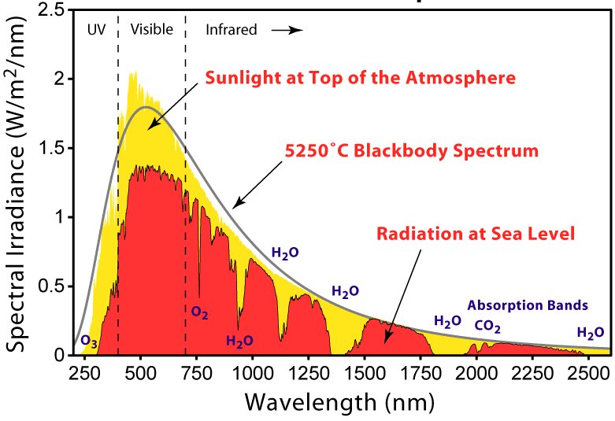
The solar radiation spectrum
Light emitted by the sun in a broad range of energies
Enough sunlight hits the earth every hour to power the world’s economy for a year.

Slide 31
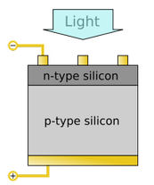
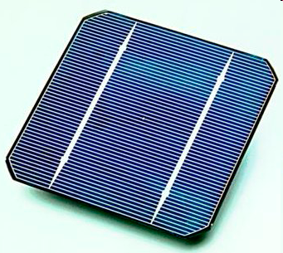
Silicon-based solar cell
Silicon (indirect gap 1.1 eV)
Sufficient thermal energy enables photovoltaic behavior despite inefficient absorbance. Cells must be fairly thick. (Direct-gap absorbers such as CIGS or CdTe can function in thin-film form.)

Slide 32
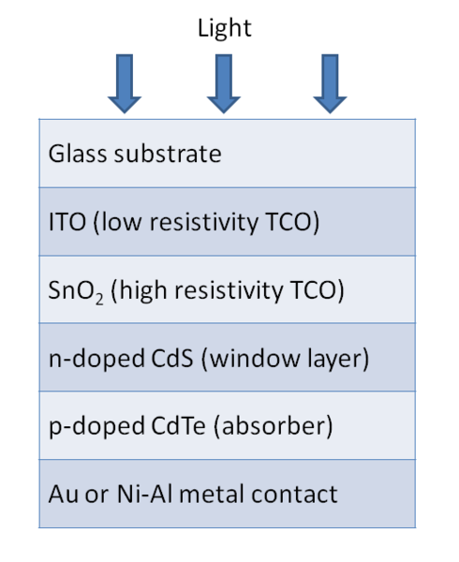
CdS/CdTe solar cell
E_{g} (CdS) = 2.45 eV
E_{g} (CdTe) = 1.45 eV

Slide 33
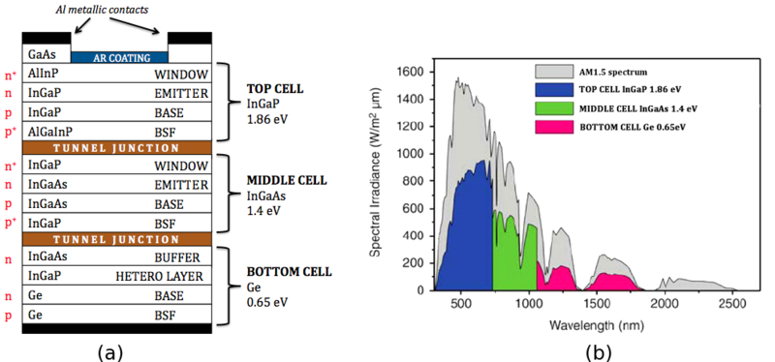
When price is no object:
III-V multijunction photovoltaics
Direct gap and ability to tailor band gap energy allows for multijunction solar cells (also known as tandem cells) which use more of the solar spectrum more efficiently (less loss of excess photon energy by waste heat)
Each junction has a different energy gap, will use a different part of spectrum
Outermost junction = largest gap; smaller gaps as you go deeper

Slide 34



Slide 35
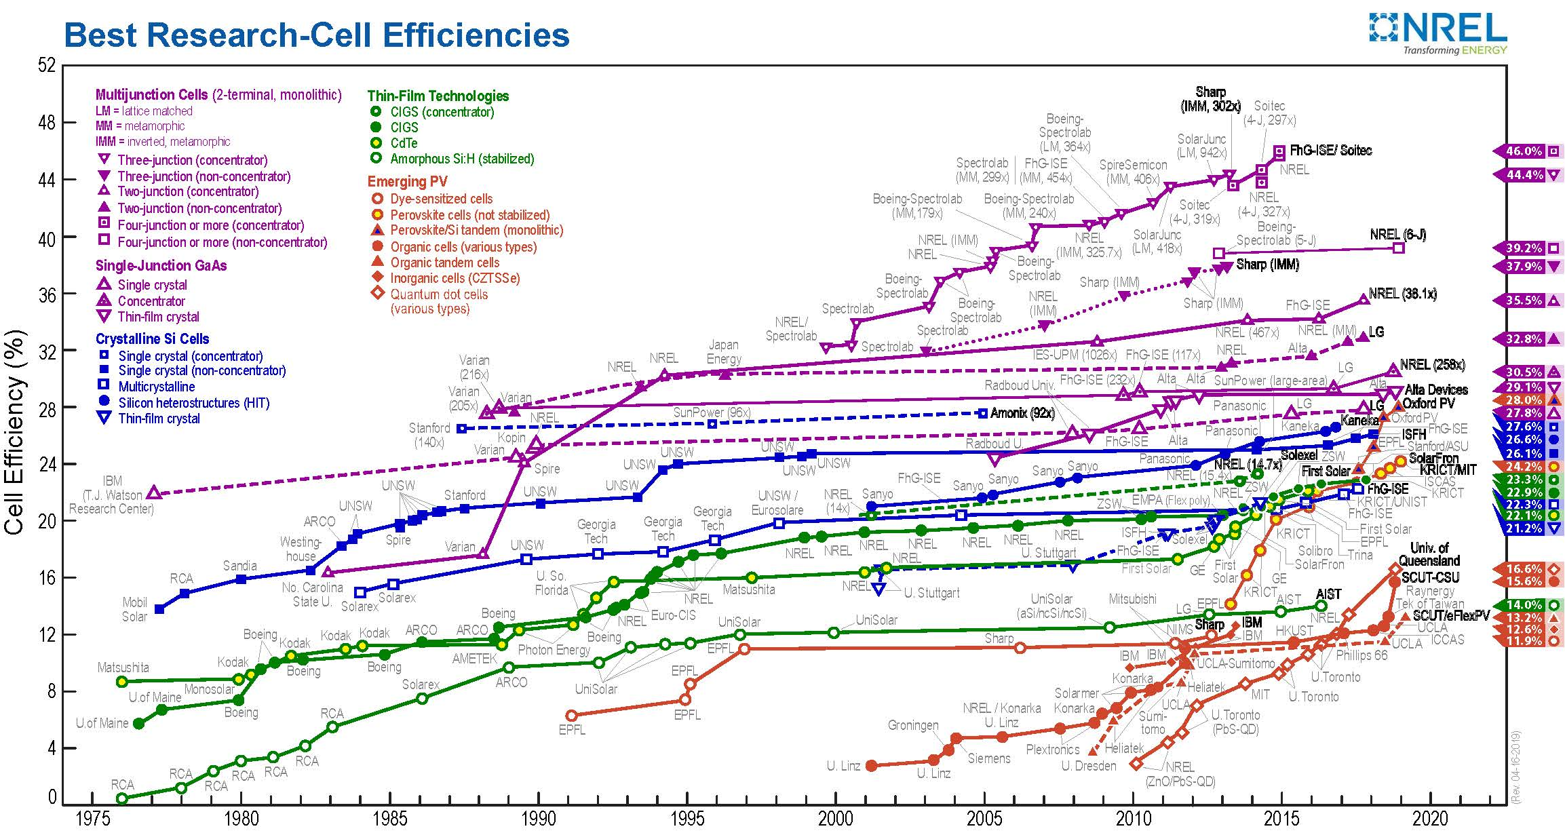
Solar cell material efficiencies
Most efficient materials are semiconducting inorganic extended solids
Excellent properties due to crystallinity and band structure

Slide 36
Flux Synthesis of Metal Chalcogenides
Flux synthesis: reaction where one low-melting elemental reactant is present in large excess, acting as a solvent.
Common metal fluxes and products
Tin flux: PrCo₂P₂, Co₇Zn₃Sn₈
Aluminum flux: Co₄Al₁₃, Y₂Al₃Si₂, CeNiAl₄Ge₂
Gallium flux: Mn₁₂₃Ga₁₃₇, Yb₃Ga₄Ge₆, Tb_{1.8}Si₈C₂B₃₆
Reactivity of the flux toward solutes varies
  Reactive solvent – flux element incorporated into the growing crystalline phase
  Unreactive solvent – not incorporated into the product

Slide 37
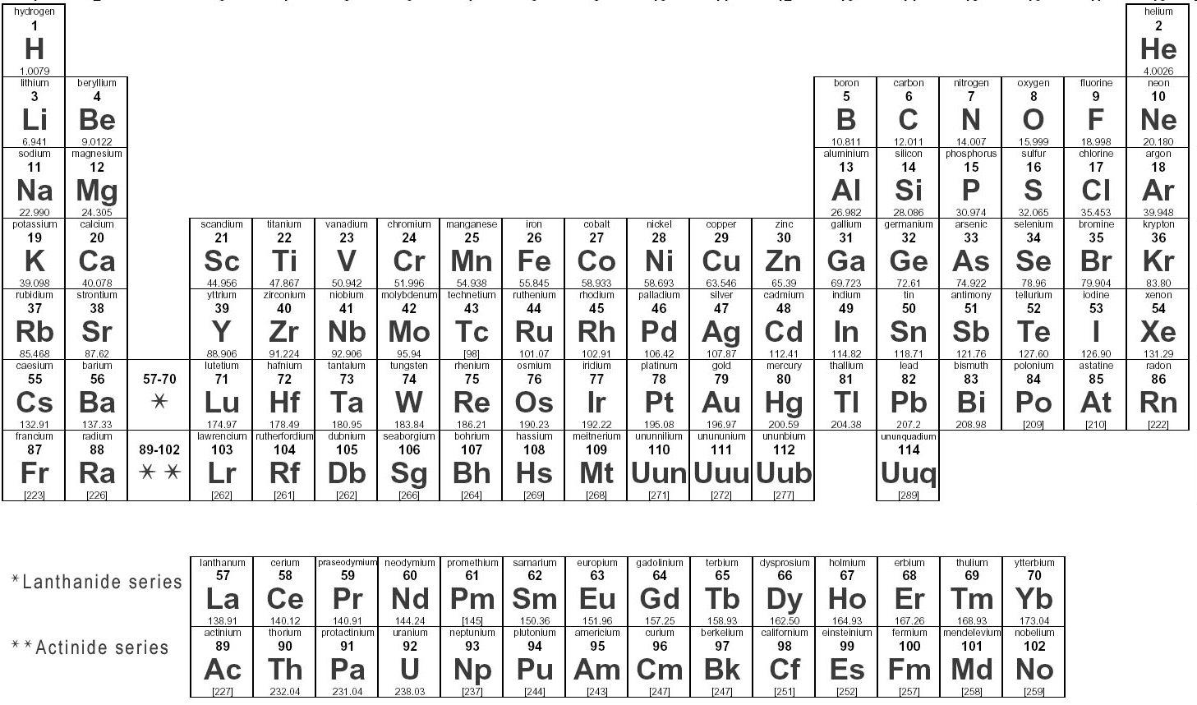
Fluxes of interest
Element m.p. (°C)
Ga 29.8
S 115
In 157
Sn 232
Bi 271
Zn 419

Slide 38
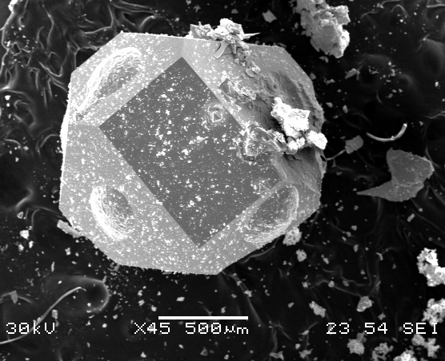
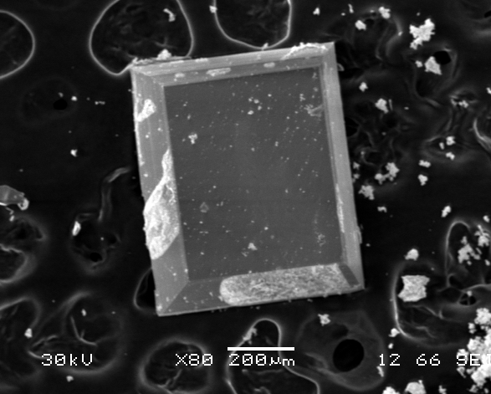
Flux Reactions
Flux synthesis advantages:
Low temperatures--kinetic/metastable products
Liquid state reaction--crystal growth
Exploratory synthesis: allows reactants to find product with local energy minimum structure
Mixed fluxes:
Lowered melting points
Can dissolve wider range of reactants

Slide 39


Flux Synthesis
Combine reactants, add excess amount of suitable flux
Heat above mp of flux, slowly cool
Centrifuge while flux still molten
Quartz tube
Temp (°C)
Quartz wool for separation of product from flux
Centrifuge
or cool and then etch
Time (hr)
Reactants and flux

Slide 40
Objective
Synthesize A_{x}M_{y}S_{z} with band gap of 1 – 2 eV
Need: charge-balancing (A²⁺ and M^{n+} cations / sulfide anions)
ability to do isovalent substitution
air-stability
sufficient yield for measurements
Ba_{x}M_{y}S_{z} or Ca_{x}M_{y}S_{z} or Zn_{x}M_{y}S_{z}
Explore different M (M = Ga, In, Sn, Bi)
React BaS or CaS or Zn with S in excess M flux
or
React BaS or CaS or Zn with M in excess sulfur flux

Slide 41
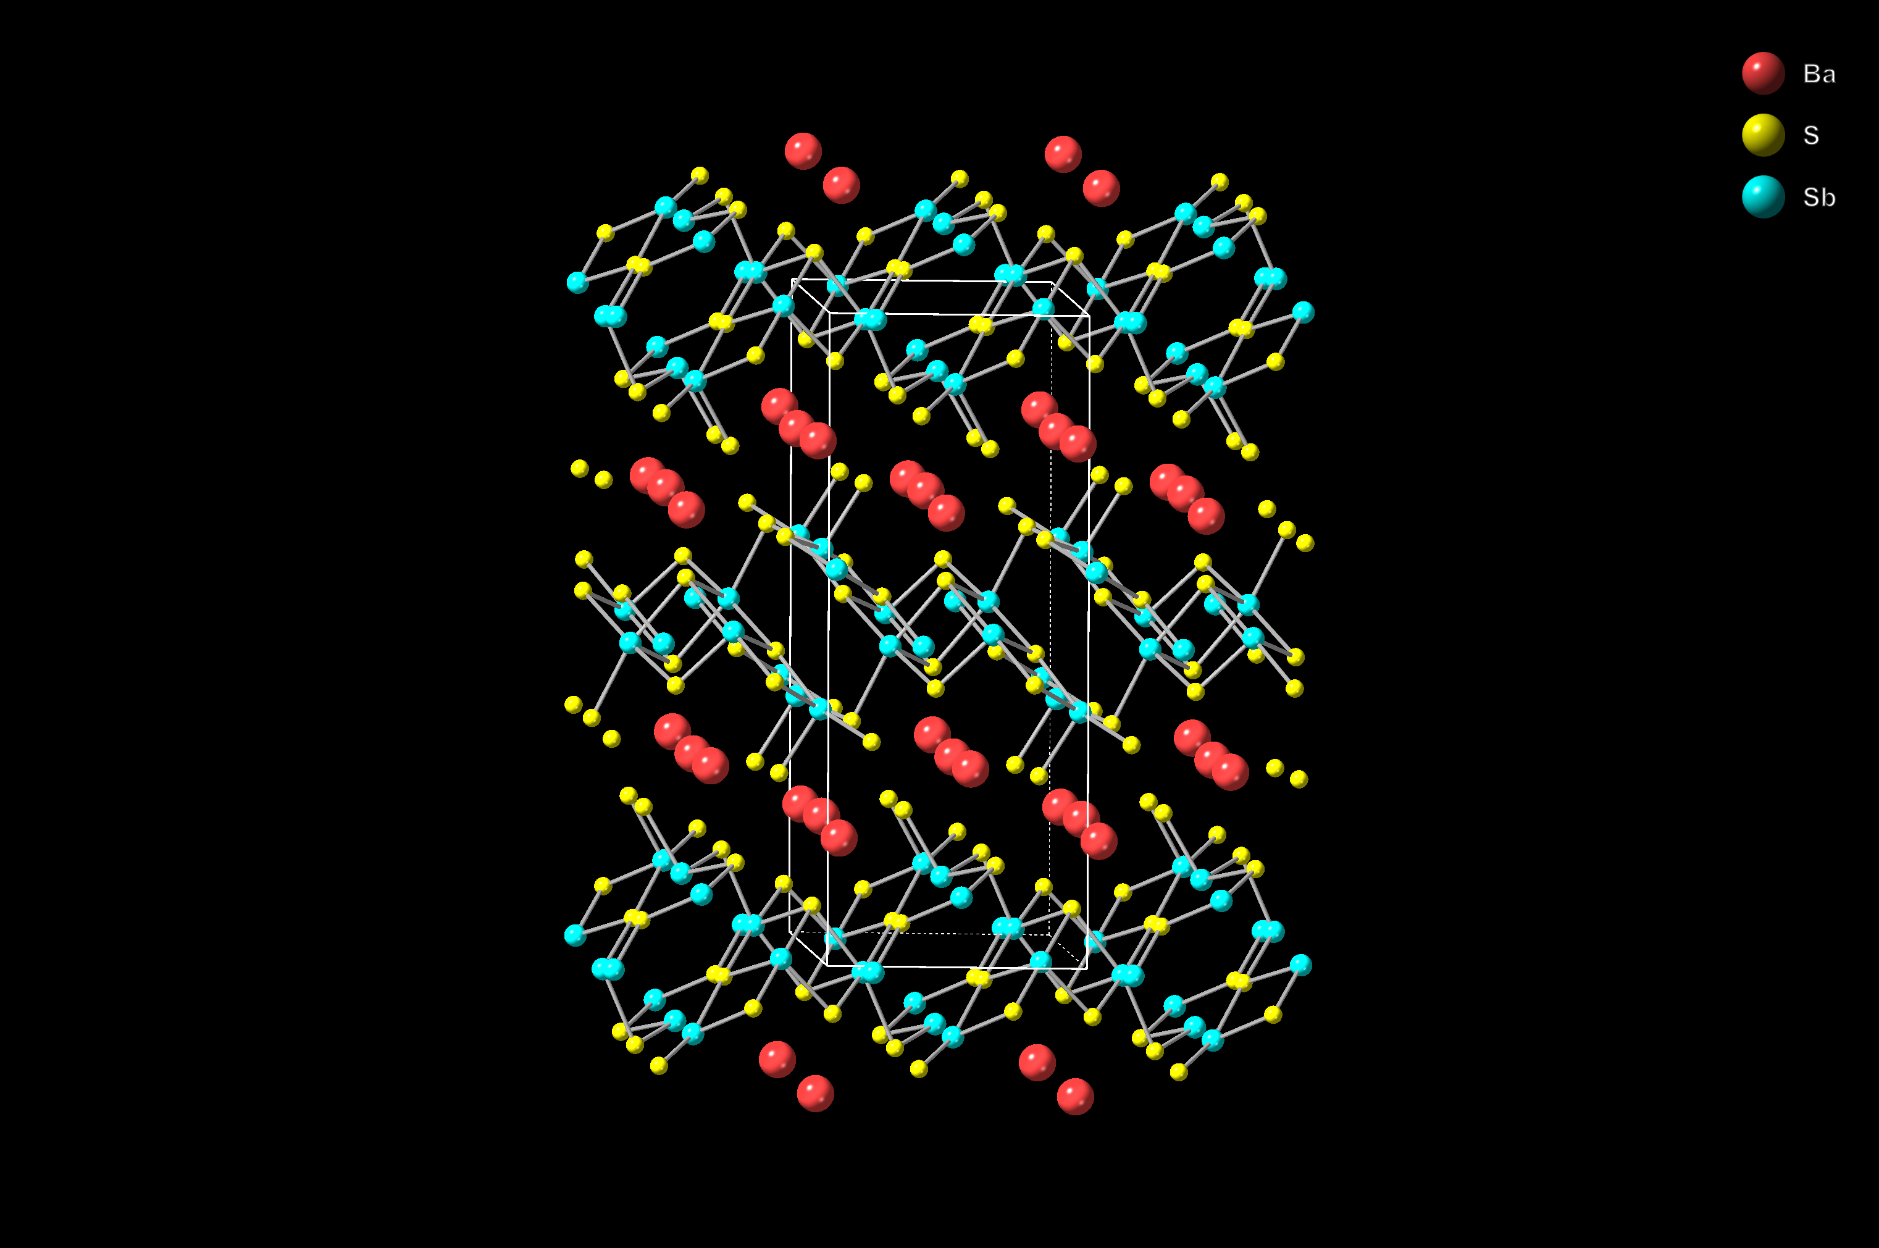
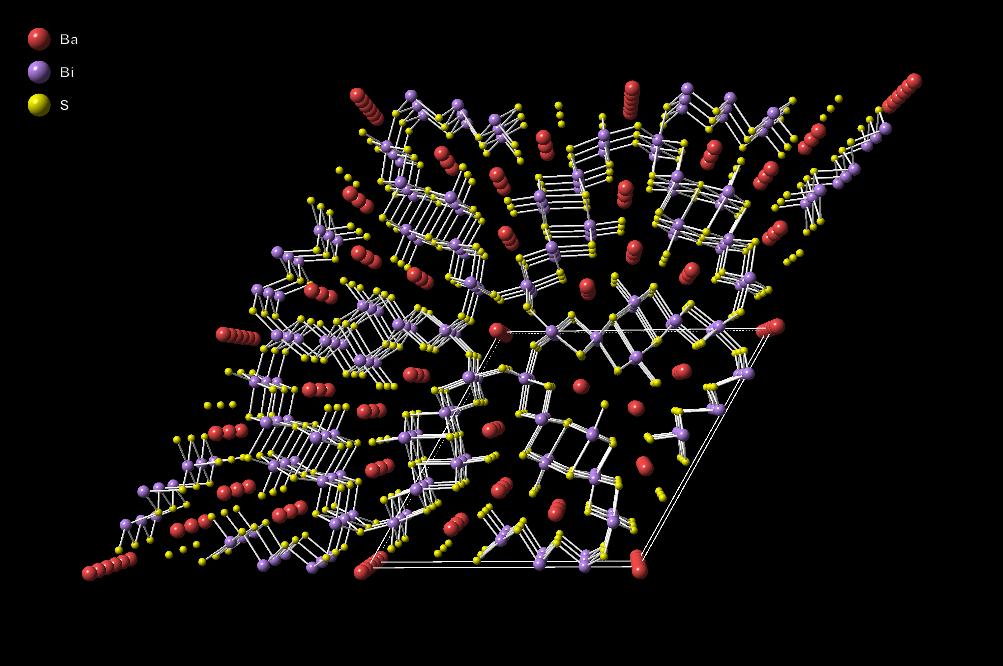
Sulfur flux growth of Ba/(Sb,Bi)/S phases
BaS + Sb in excess sulfur flux → BaSb₂S₄ (monoclinic, red powder; Eg = 1.6 eV)
BaS + Bi in excess sulfur flux → BaBi₂S₄ (hexagonal, black powder; Eg = 1.2 eV)
BaS + Sb and Bi in excess sulfur flux → Ba(Sb_{1-x}Bi_{x})₂S₄
with 0 < x < 0.3 at which point structure changes

Slide 42
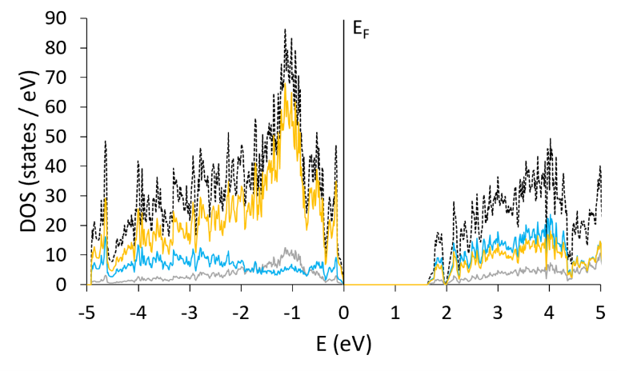
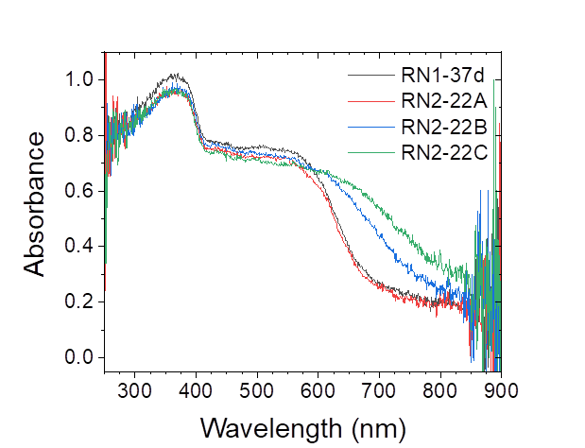
Ba
Sb
S
Bandgap of 1.6 eV will shrink as Sb is substituted by Bi
Confirmed by UV/Vis/NIR spectroscopy

Slide 43
Metal flux allows higher temperatures
BaS / S / M flux
Need high enough temperature for BaS, S, M_{x}S_{y} to react; crystal growth
Possible sulfur vapor pressure?
Canfield et al. found ratio up to S₄₀Bi₆₀ can be heated up to 1000 °C without rupturing tube or detectable evaporation of S

Slide 44
BaS + S in excess M flux
Possible products
BaS / S / Bi
α-BaBi₂S₄, β-BaBi₂S₄
BaS / S / Sn
BaSnS₂, Ba₃Sn₂S₇, BaSn₂S₃, Ba₂SnS₄, Ba₇Sn₃S₁₃, Ba₁₂Sn₄S₂₃, Ba₇Sn₅S₁₅, BaSn₂S₅, Ba₆Sn₇S₂₀, Ba₈Sn₄S₁₅, BaSn₃S₄, BaSnS₃
BaS / S / Ga
BaGa₄S₇, Ba₂Ga₂S₅, Ba₅Ga₂S₈, Ba₄Ga₂S₇, Ba₃Ga₂S₆, Ba₄Ga₂S₈, BaGa₂S₄
BaS / S / In
BaIn₂S₄, Ba₂In₂S₅, Ba₁₂In₄S₁₉, Ba₄In₂S₈

Slide 45
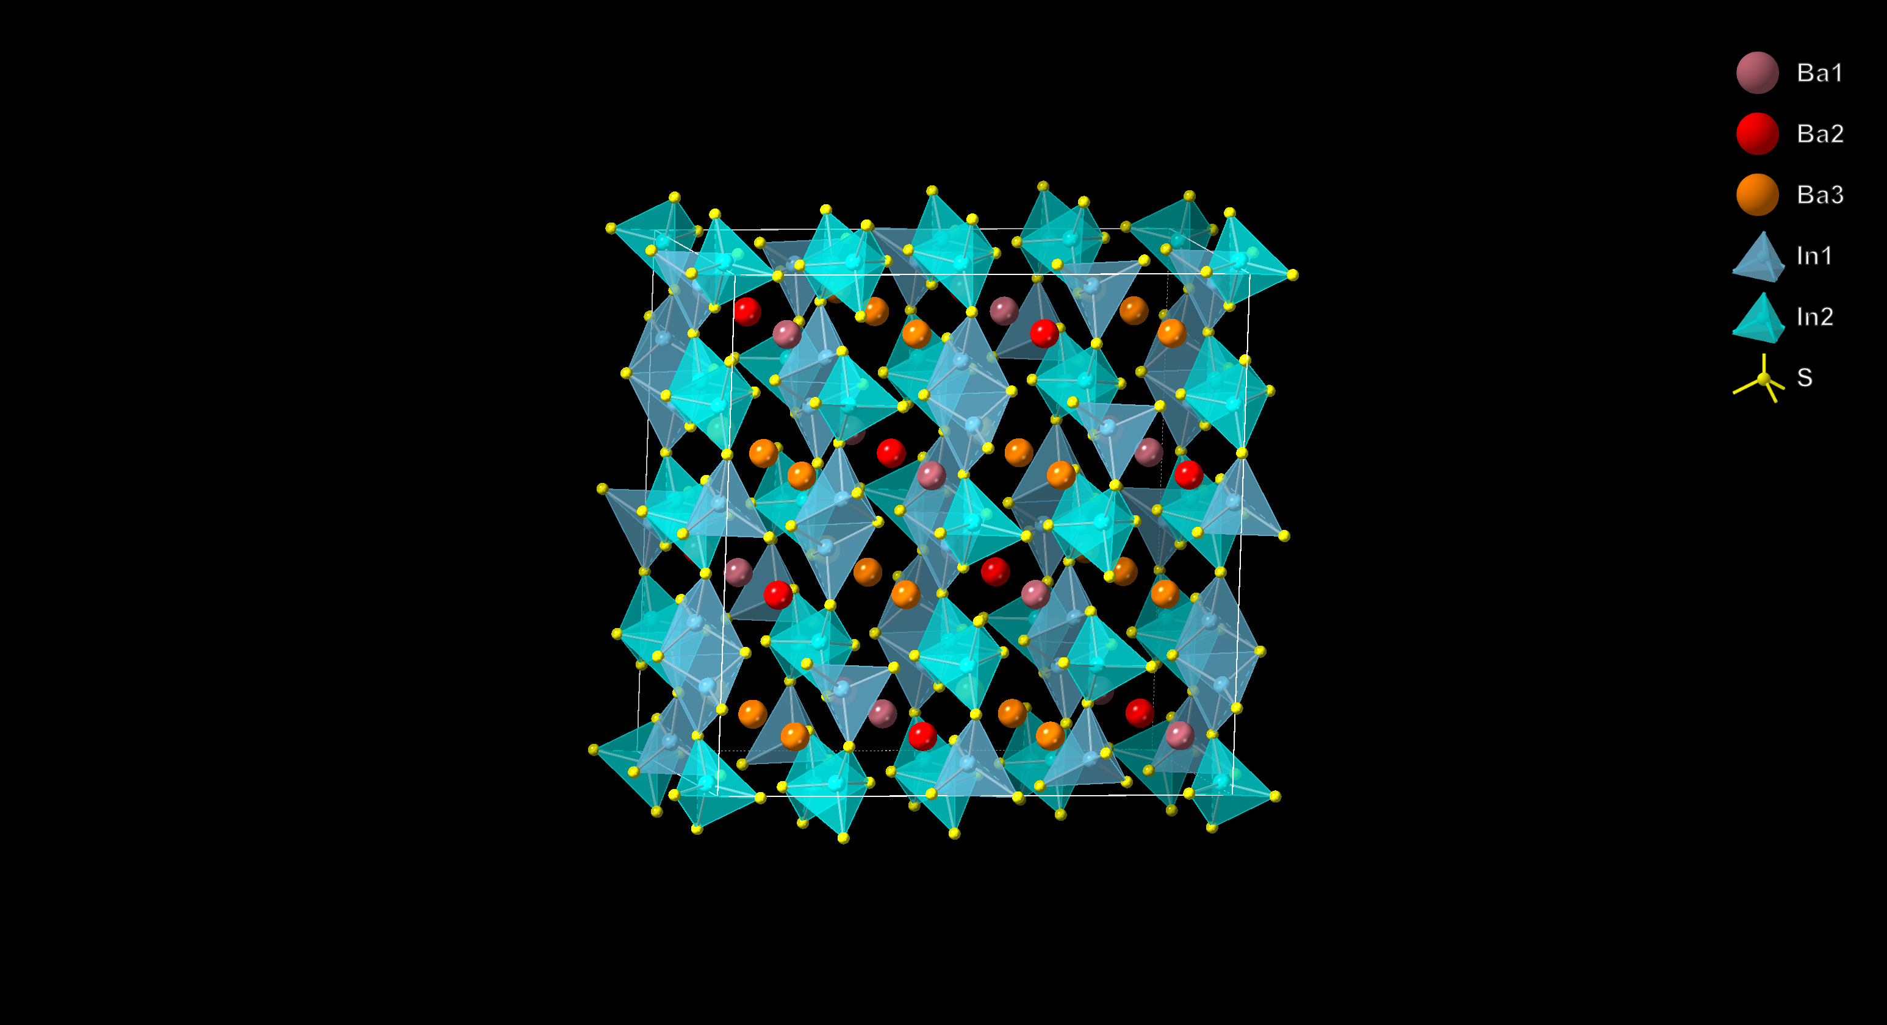
Indium flux reactions
BaS + S in excess of indium metal (1:1:10 mmol ratio)
Product targeted: BaIn₂S₄
Allows for substitution on several sites to modify Eg
Unfortunately, InS forms very readily!

Slide 46
Final thoughts on metal chalcogenides
Wide variety of binary and ternary chalcogenides with potentially useful properties
Semiconducting compounds of potential interest as solar cell materials, pigments, LED’s
Considerations that need to be balanced for solar cells:
Efficiency of cell
Price of processing/purity needed
Abundance of elements
Toxicity of elements
Making these materials nanosized (quantum dots) is also a huge field (Strouse, et al.)!

